Slide 1

PiDP10
17th October 2025
Notes:
BuroHappold Base Corporate Presentation_Issue 004 2016

Slide 2
Installation

Slide 3
Documentation
PiDP10 user manual: https://obsolescence.dev/pidp10-sw/PiDP-10_Manual.pdf
ITS user manual: https://obsolescenceguaranteed.blogspot.com/2020/02/a-turists-guide-to-its.html
Primer on ITS: https://github.com/PDP-10/its/blob/master/doc/_info_/its.primer
Wiki: https://github.com/larsbrinkhoff/its-manual/wiki
Emacs: https://www.gnu.org/software/emacs/refcards/pdf/refcard.pdf
PDP-10 Assembler: http://pdp10.nocrew.org/docs/instruction-set/pdp-10.html

Slide 4
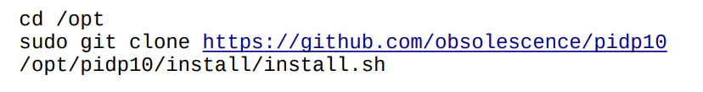
Installing PiDP10
https://obsolescence.dev/pidp10-sw/PiDP-10_Manual.pdf
The simulation, simh, requires the 64-bit version of the Pi OS operating system
Download the PiDP10 software
The installer asks a lot of questions. to which the answer is ‘y’
But there is no need to download the source code

Slide 5
Installing on X86 LINUX
https://obsolescence.dev/pidp10-sw/PiDP-10_Manual.pdf
Install the same software on the x86 Linux system
Say N to the following questions:
Automatically start the PiDP-10 core when logging in?
Add a DEC flavour to the Pi's desktop?
Reduce telnet release time?
Say Y to the following question:
Install required dependencies for running the PiDP-10?
After installation, rebuild for x86
cd /opt/pidp10/bin
tar xzvf binaries-for-x86-64.tar.gz

Slide 6
Using ITS

Slide 7
Starting ITS ON PiDP10
When the Raspberry Pi starts, pdpcontrol start runs
The front panel is read to decide which operating system to boot
With no front panel, in the Raspberry Pi terminal, run pdpcontrol stop, wait for the simulation to stop, then run pdpcontrol start X, where X is the number of the system to boot
For ITS, use pdpcontrol start 1
Command | Meaning
pdpcontrol stop | Stop PiDP10
pdpcontrol start | Start PiDP10, using the front panel to select the operating system
pdpcontrol start N | Start PiDP10: 1= ITS 2= TOPS-10 200= TOPS-20

Slide 8
Starting Terminal
Terminals are started using pdp terminal, or by double clicking on the icon on the left-hand side of the screen
Command | Meaning
pdp con | Starts teleprinter
pdp telcon | Starts telnet
pdp vt52 | Starts VT52 terminal
pdp tvcon | Starts Knight TV graphical terminal

Slide 9
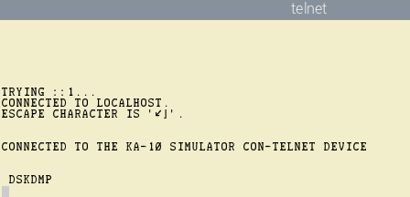
Teleprinter and Telnet
Using pdp con or pdp telcon, or the CON or TELCON icons on the left-hand side, start a terminal
(Restarting using pdpcontrol stop closes the terminal)
Wait until the DSKDMP prompt appears
Boot ITS using its<return><esc>G
Booting message appear in the teleprinter or telnet windows

Slide 10
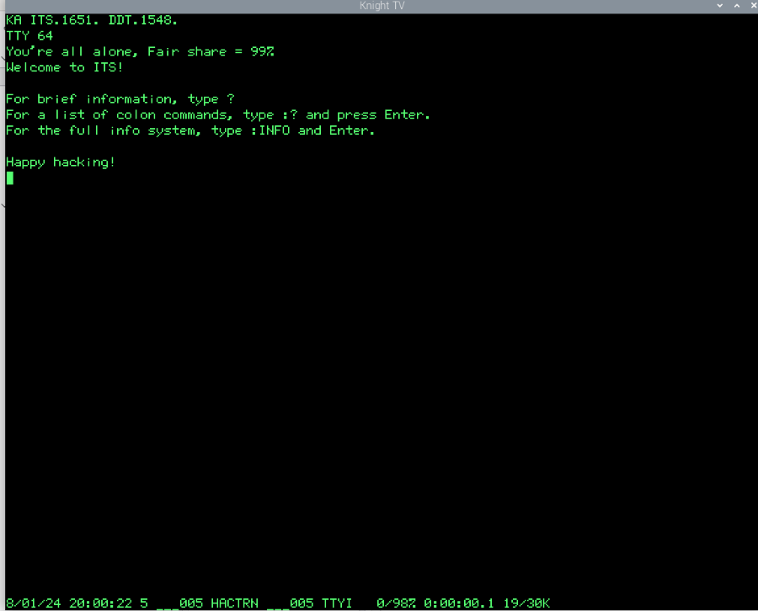
Knight TV
Using pdp tvcon or the KNIGHT icon on the left side of the screen
Once ITS is running, login using the CALL sequence, F1, the terminal had a special CALL key

Slide 11
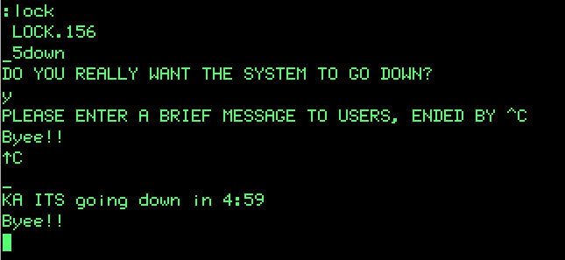
Stopping PDP-10
https://obsolescenceguaranteed.blogspot.com/2020/02/a-turists-guide-to-its.html
Type :LOCK
Type 5DOWN against the _ prompt
The number is the number of minutes to wait
ITS will ask if you want to halt the system, answer Y
Type a message and press Ctrl-C
If you are logged out then the system goes down immediately
If you’re still logged on, press Q and then :LOGOUT

Slide 12
Folders
A user account has folders under a root folder
There is only one layer of folders
The user has a folder with their name, which is the default folder when they log on
The current working folder is shown at the bottom of the Knight terminal
All folders are available to all users
User LARS
LARS
GAMES
.

Slide 13
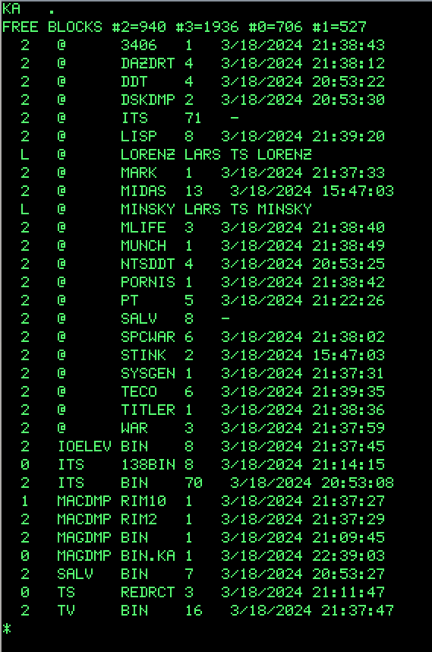
System Folder
The . folder is the system folder
It contains the operating system @ ITS, as well as commands like Lisp, @ LISP

Slide 14
names
A user name cannot contain more than 6 letters, and are all upper case
A filename comes in four parts:
Device, followed by a colon
Folder, followed by a semi-colon
First and second parts of the filename, separated by a space
Written Device:Folder;First Second
If a device or folder is omitted the current values are used
The ITS executable has first name (FN1) of @, in folder ‘.’, so full name of ‘.;@ ITS’

Slide 15
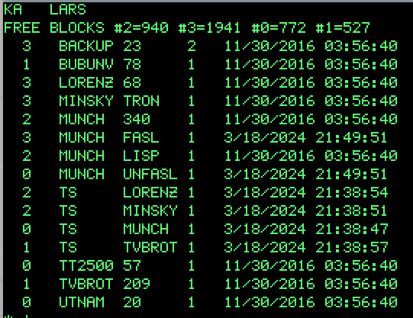
Folder listing
In the first line is the device (KA) and the folder name (LARS)
In the second line is the number of free blocks (1K words) for each of the four hard drives, numbered #0 through #3
Each file is listed in turn:
First column is the drive number
Second and third columns are the filename
Fourth column is file size in 1K word blocks

Slide 16
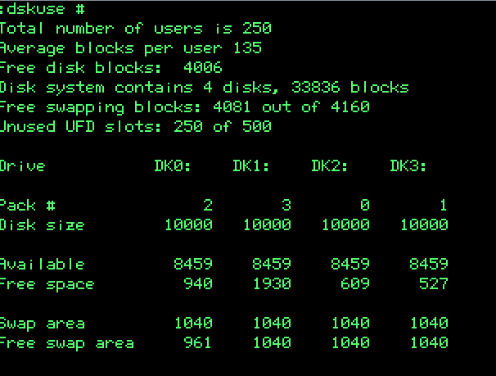
DISK USAGE
The disk usage can be found using :dskuse
By itself, :dskuse shows the user’s directory, and how much storage has been used
Using :dskuse # shows the disk packs / drives, and how much storage has been used in total
Using :dskuse directory shows how much storage has been used in the directory

Slide 17
Basic Commands
All commands are typed against the left edge of the screen
Available commands can be listed using :?
Commands are prefixed with a colon, for example to change to another folder use :CWD folder
Command | Shortcut | Description
:LOGIN user | user<esc>U | Login to account user
:LISTF :DIR | Ctrl-F | List current folder
:CWD folder |  | Change current folder to folder
:LISTJ | <Esc><Esc>V | List jobs
:CLEAR | Ctrl-L | Clear terminal
:LOGOUT | <Esc><Esc>U | Logout

Slide 18
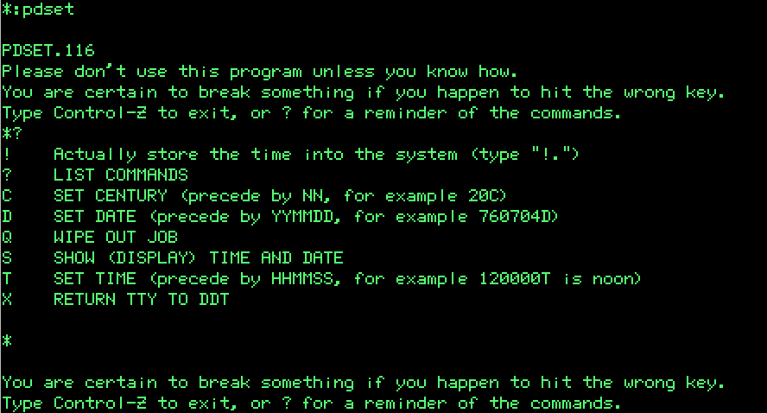
Changing the system date and time
The system time and date is set using :PDSET
From within the program, you can set the time and date, with commands HHMMSST and YYMMDDD respectively, writing it to the system with !. and leaving the program with Ctrl-Z

Slide 19
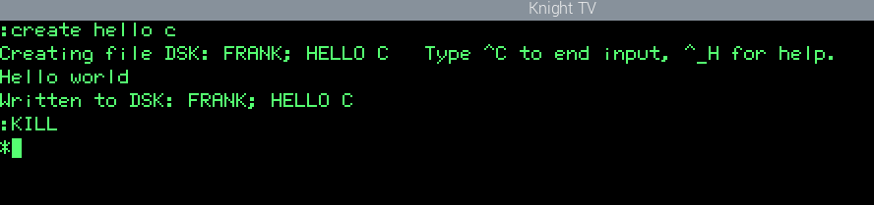
Creating a new File
A new file can be created in the current folder using :CREATE filename1 filename2
Text can be entered into the file
When done, press Ctrl-C to save and quit

Slide 20
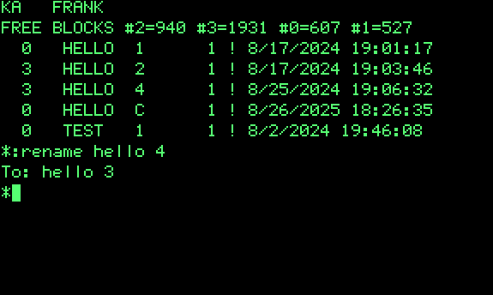
Copying Deleting Moving / rename files
The command to copy a file is :COPY filename filename2
The command to delete a file is :DELETE filename filename2
The command to move or rename a file is :RENAME filename filename2
Here filename and filename2 are the two six-character parts of the filename
The system is more interactive than Linux, so for copy and rename, you supply only the original filename, and then ITS will ask for the target filename

Slide 21
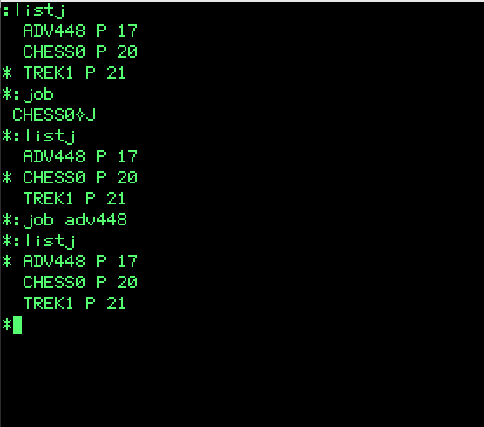
Jobs #1
Multiple jobs can be run simultaneously
When a process is running, it can be halted by typing Ctrl-Z on a standard terminal, or F1 on a Knight console
Jobs can then be listed using :LISTJ
The currently select jobs has an asterisk against the name
The command :JOB rotates the selection through the list, or select directly with :JOB NAME
The command :KILL kills the currently selected job

Slide 22
Jobs #2
A list of jobs has the following format:
First column, asterisk if the job is the currently selected job
Second column, the name of the job
Third column, the job status
R running
P stopped
W waiting for terminal
Fourth column, index number

Slide 23
Create a new user
https://github.com/larsbrinkhoff/its-manual/wiki/Adding-a-new-ITS-user
To create a new user, it is necessary to run ^R NAME; ..NEW. (UDIR)
The command is entered as shown, except that NAME is replaced by the actual user’s name (FRANK)
A user account is automatically deleted if the folder is empty, and so a new file must be added to the folder, e.g. by running :CREATE, and saving the file with Ctrl-C
Run :HSNAME to show the current user’s name

Slide 24
Interesting Programs
Folder | Command | Description
LARS | MINSKY | Minskytron display
LARS | LORENZ | Lorenz strange attractor simulator
GAMES | CHESS2 | Chess game on the Knight terminal
GAMES | TREK | Star Trek game
GAMES | TVWAR | Space War on Knight terminal
SHRDLU | TWDEMO, Ctrl-Q | The SHRDLU AI demonstration on the 340 display

Slide 25
Using TOPS-20

Slide 26
Starting TOPS-20 ON PiDP10
When the Raspberry Pi starts, pdpcontrol start runs
The front panel is read to decide which operating system to boot
With no front panel, in the Raspberry Pi terminal, run pdpcontrol stop, wait for the simulation to stop, then run pdpcontrol start X, where X is the number of the system to boot
For TOPS-20 use pdpcontrol start 200
Command | Meaning
pdpcontrol stop | Stop PiDP10
pdpcontrol start | Start PiDP10, using the front panel to select the operating system
pdpcontrol start N | Start PiDP10: 1= ITS 2= TOPS-10 200= TOPS-20

Slide 27
Starting Terminal
Terminals are started using pdp terminal, or by double clicking on the icon on the left-hand side of the screen
TOPS-20 doesn’t have a Knight TV console, but it does have the 340 type graphics display
Command | Meaning
pdp con | Starts teleprinter
pdp telcon | Starts telnet
pdp vt52 | Starts VT52 terminal

Slide 28
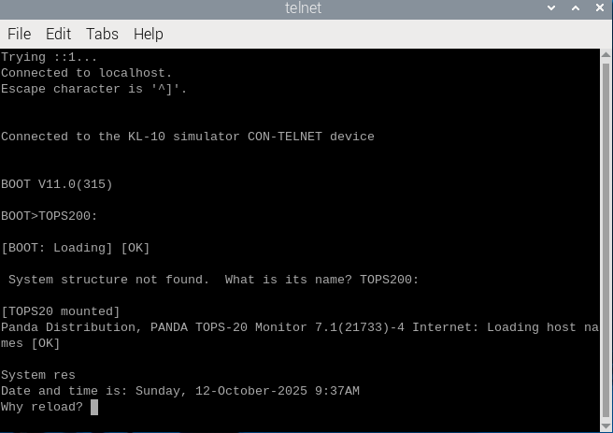
Booting the system #1
Use pdp telcon, the teletypewriter is too slow during the boot
(Restarting using pdpcontrol stop closes the terminal)
Wait until the BOOT> prompt appears
Type TOPS20: (include colon)
When the system complains that it can’t find the correct structure, again type TOPS20: (all upper case)

Slide 29
Booting the system #2
The system asks why it needs to be reloaded, and you answer SA
The system also asks if it needs to run checks, and the answer is N

Slide 30
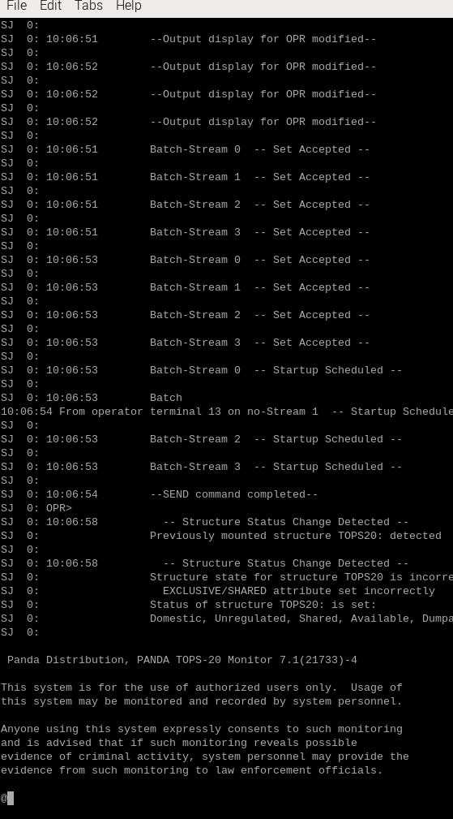
Booting the system #3
When the boot text stops being printed, after the sequence starting with SJ, press Ctrl-C and after a couple of paragraphs about Panda the @prompt appears
The @ is the unprivileged user prompt

Slide 31
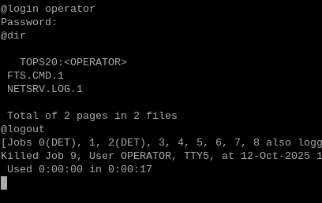
Logging in and out
Type term vt100 so that the backspace key works properly
At the @ prompt, type login operator
At the password prompt, type dec-20
Nothing is printed to show that the login is successful, so type dir
Type logout to log out

Slide 32
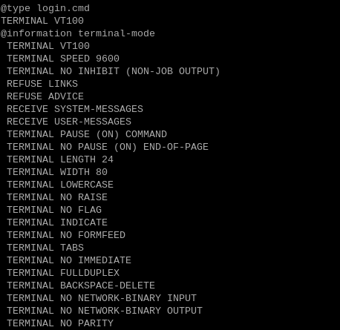
Running Commands during login
Create a new file called login.cmd, using at the @ prompt create login.cmd
Into the Emacs screen type TERMINAL VT100
Save the file with Ctrl-X Ctrl-S, and exit Emacs using Ctrl-X Ctrl-C
The current terminal mode can be displayed using information terminal-mode

Slide 33
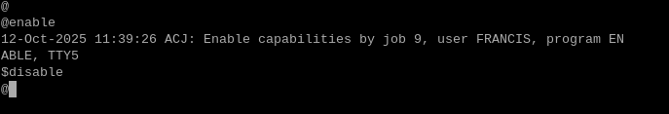
Privileged status
Privileged status is like sudo or doas on Linux or BSD, requires wheel status
From the @ prompt, type enable or ena to enable privileged status, a $ prompt indicates that you have privileged status
After issuing the commands required at the $ prompt, leave privileged status by typing disable or dis, which puts you back with the @ prompt

Slide 34
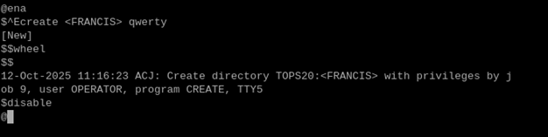
Creating a new user #1
To create a new user, you must be logged in, and have wheel status
Enable privileged status at the @ prompt with enable
At the $ prompt, type Ctrl-Ecreate <username> password, for example Ctrl-Ecreate <francis> qwerty
The angled brackets are a mandatory part of the username during creation of the account - the username case is not important

Slide 35
Creating a new user #2
A new prompt [New] is created by the system, at which point we can enter the user’s privileges
Against the $$ prompt type wheel, and then Ctrl-M to end data entry
At the $ prompt type disable to go back to the normal user status

Slide 36

Shutting down the PDP-10
To shut down the system, you must be logged in, and have wheel status
Enable privileged status at the @ prompt with enable
Then type Ctrl-E cease now
The system will ask for confirmation, which is supplied by pressing the Enter key
Wait for the message “Shutdown complete”
On the Pi terminal, run pdpcontrol stop

Slide 37
names
A user name cannot contain more than 6 letters, and are all upper case
A filename comes in four parts:
Device, followed by a colon
Folder, followed by a semi-colon
First and second parts of the filename, separated by a space
Written Device:Folder;First Second
If a device or folder is omitted the current values are used
The ITS executable has first name (FN1) of @, in folder ‘.’, so full name of ‘.;@ ITS’

Slide 38
Emacs

Slide 39
Emacs
Emacs can be started with :EMACS [filename]
Closing Emacs with Ctrl-X Ctrl-C stops the job, which can be restarted with :CONTINUE (or Esc-P), it doesn’t end Emacs
Emacs can be ended using :KILL
Sequence | Description
Ctrl-X Ctrl-S | Save buffer to file
Ctrl-X Ctrl-C | Close Emacs

Slide 40
EMACS NAVIGATION
https://obsolescenceguaranteed.blogspot.com/2020/02/a-turists-guide-to-its.html
In the Turists guide to ITS, under “Using the Emacs editor”, are shown the keyboard combinations
Sequence | Description
Ctrl-F | Forward one char
Ctrl-B | Backwards one char
Meta-F | Forwards one word
Meta-B | Backwards one word
Ctrl-A | Go to start of the line
Ctrl-E | Go to the end of the line
C-A
M-B
C-B
C-F
M-F
C-E

Slide 41
EMACS NAVIGATION
https://obsolescenceguaranteed.blogspot.com/2020/02/a-turists-guide-to-its.html
In the Turists guide to ITS, under “Using the Emacs editor”, are shown the keyboard combinations
Sequence | Description
Ctrl-P | Go to previous line
Ctrl-N | Go to next line
Meta-V | Go up one screen
Ctrl-V | Go down one screen
Meta-< | Go to start
Meta-> | Go to end
M-<
M-V
C-P
C-N
C-V
M->

Slide 42
PiDP-10

Slide 43
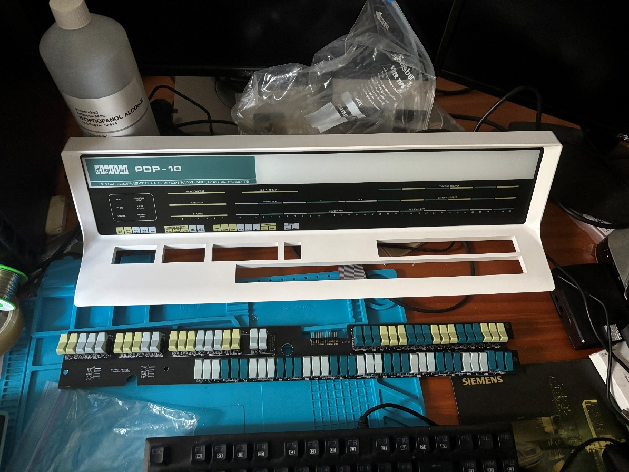
PiDP-10 Operator Console

Slide 44
Switch Positions
There are two kinds of switch in the PiDP-10 console:
Toggle
Momentary
In both cases, if the switch is higher at the front of the unit than the back, the value is zero
In both cases, if the switch is higher at the back of the unit than the front, the value is one
0
1
Front

Slide 45
Booting An operating system #1
When the Raspberry Pi boots, the rightmost eight data switch positions are used to determine what to do next
If the switches are set to 001 then the tape-loader for ITS is started, 002 for TOPS 10, 200 for TOPS 20
The lowest octal digit specifies KA-10, and the higher octal digit specifies KL-10; there is currently no KI simulation
Any other value, Blinky is run instead
Switches | Operating system
001 | ITS
002 | TOPS 10
200 | TOPS 20
Octal | PDP-10
--X | KA-10
-X- | KI-10
X-- | KL-10

Slide 46
Booting An operating system #2
For ITS, with the paper tape reader, if the PiDP-10 is already powered up, set the switches as before, press momentary switches Stop and then Read In - pdpcontrol stop, pdpcontrol start 1 in effect
Switches | Operating system
001 | ITS
002 | TOPS 10
200 | TOPS 20
Octal | PDP-10
--X | KA-10
-X- | KI-10
X-- | KL-10

Slide 47
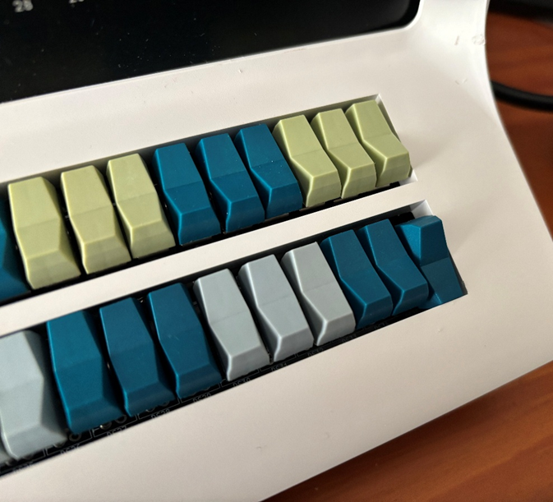
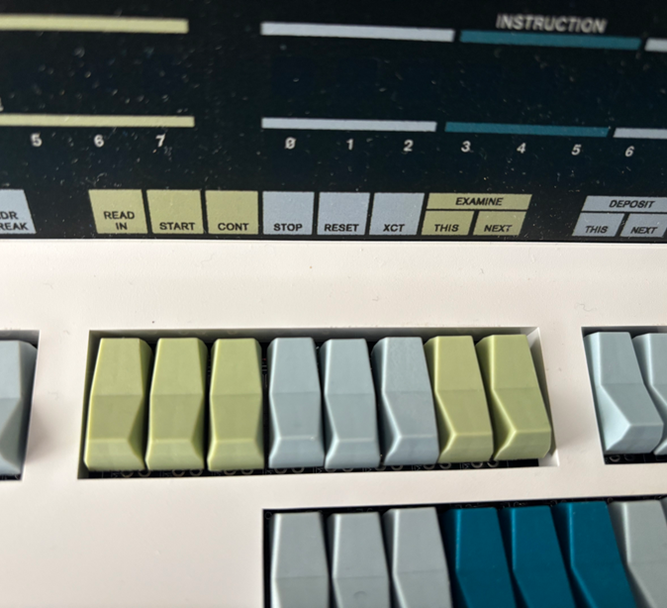
Booting ITS
1
3
2

Slide 48
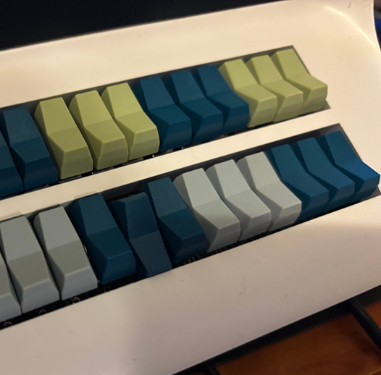
Booting TOPS-20
1
3
2

Slide 49
Programming the PDP-10 using MIDAS on ITS

Slide 50
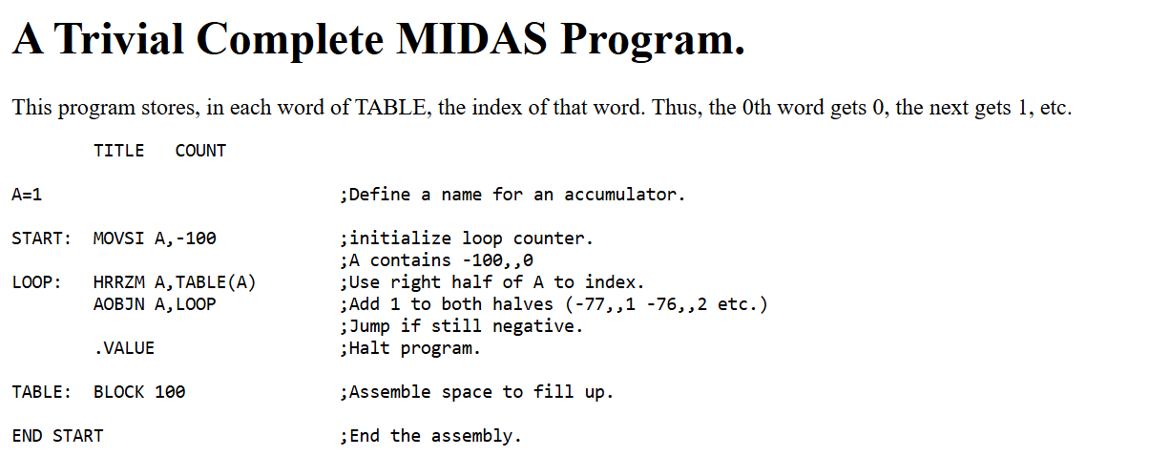
Example MIDAS Code
http://pdp10.nocrew.org/docs/instruction-set/Program.html

Slide 51
PDP-10 Assembler
https://bitsavers.org/pdf/dec/pdp10/TOPS10/1973_Assembly_Language_Handbook/01_1973AsmRef_SysRef.pdf
PDP-10 assembler has two basic formats:
Functions
I/O
Functions
OP
M
A
I
X
Y
0
6 7
8 9
12 13 14
17 18
35
I/O
7
DC
IC
I
X
Y
0
2 3
9 10
12 13 14
17 18
35

Slide 52
OPERATION Field OP
Includes bits 0 .. 6
Three octal digits (rightmost two bits are field M)
Functions include:
Arithmetic, integer and single precision
Logical
Shift, rotate, swap register halves
Jump, push, pop

Slide 53
Mode Field M #1
The rightmost two bits of the first three octal digits are mode field M (bits 7,8)
There are four choices - Basic ( ), Immediate (I), Memory (M), and Self/Both (S / B) - which determines the direction flow, from source to destination
Because these two bits are located within the three octal digits of the function, the handbook lists separate function codes for each value of M
Code | Value | Direction
(none) | 0 | Memory -> Accum
I | 1 | Value -> Accum
M | 2 | Accum -> Memory
S / B | 3 | Memory -> Memory (and Accum if non zero)

Slide 54
Mode Field M #2
Where the source or destination is Accum then the accumulator is given by the four bits of field A
Where the source or destination is Memory, the supplied effective address in fields I, X and Y is used to work out where to read or write the data
If the mode is Self (S) or Both (B) then the accumulator given by field A also gets a copy (if field A is non-zero)
Code | Value | Direction
(none) | 0 | Memory -> Accum
I | 1 | Value -> Accum
M | 2 | Accum -> Memory
S / B | 3 | Memory -> Memory (and Accum if non zero)

Slide 55
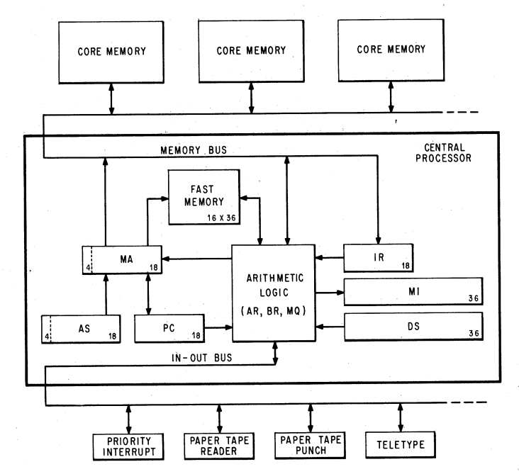
Accumulator FIELD a
Where the source or destination is Accum, this is given by the 4 bits of field A, bits 9 through 12
This references the 16 accumulators in low memory addresses 00₈ through 17₈

Slide 56
Effective Address FIELDS I, x AND y
The effective address, E, is constructed from three fields: I, X and Y
Y is an 18-bit-sized field, from bit 18 through bit 35
If X is not zero, the contents of the accumulator with number X is added on
If I is zero, then this is E
If I is one, the 18 leftmost bits at the location pointed to be E are themselves turned into an effective address, iteratively
Y
A (X!=0)
I=1
+
I=0

Slide 57
I/O instruction Code Field IC
The instruction code is in two parts:
Bits 0 - 2, always of value 7₈
Bits 10 - 12. which says which command we are doing
Bits 10 - 12 are within two octal digits
Bits 10 and 11 in the first octal digit
Bit 12 in the second octal digit
Hence the instruction code is 0..3, and then 4 or 0
With a fixed device ID, the first 13 bits, bits 0 .. 12 are fixed

Slide 58
I/O Device Code Field DC
Device | Code | Device | Code
APR | 000 | DSK | 170
PI | 004 | DTC | 320
ADC | 024 | DTS | 324
PTP | 100 | DLS | 240
PTR | 104 | DC10B/E | 240
TTY | 120 | TMC | 340
LPT | 124 | TMS | 344
PLT | 140 | CCI | 014
CR | 150
The device code is bits 3 through 9, for a total of 7 bits, 128 possible codes
This is 3 octal digits, with the last digit being 4 or 0
With a fixed device ID, the first 13 bits, bits 0 .. 12 are fixed
PTR = Paper Tape Reader

Slide 59
Move [X,,Y]
There are four official ways to use Move, but also there is a fifth way as well provided by the macro assembler
MOVE can load an immediate half word value using MOVEI AC, VALUE
MOVE can load from memory using MOVE AC, EA
The macro assembler can also load an immediate full word, from an address in memory provided by the assembler, of type MOVE AC, [X,,Y], where X and Y are two halves of a full word of that underlying memory location
Code | Value | Direction
(none) | 0 | Memory -> Accum
(none) | 0 | [X,,Y] -> Accum
I | 1 | Value -> Accum
M | 2 | Accum -> Memory
S / B | 3 | Memory -> Memory (and Accum if non zero)

Slide 60
Blocks
A block is defined using BLOCK
The format is LABEL: BLOCK N
This reserves N words of memory, between LABEL and LABEL+(N-1), which can be accessed as a table using the LABEL address
The block is usually defined at the end of the code, after the code which terminates the program
LABEL: BLOCK 5
4
3
2
1
0
LABEL

Slide 61
Stack and Stack Pointer #1
STACK: BLOCK 5
The PDP-10 doesn’t have a stack pointer as such
Instead, one of the accumulators, by convention AC17₈ is used as the stack pointer, and the stack pointer variable is conventionally called P
The name P is defined to be 17₈, using P=17 at the start of the code
4
3
2
1
0
LABEL
-1
P

Slide 62
stack and Stack Pointer #2
STACK: BLOCK 5
A table is created using STACK: BLOCK N, and enabled using MOVE P, [-N,,STACK-1]
The upper 18 bits holds the count into the stack; the bottom 18 bits holds an address just below the stack
It is STACK-1, because when pushing data, the address is incremented first before storing the value
It is -N because the counter is incremented as well; if it becomes zero then an overflow occurs
4
3
2
1
0
PC
STACK
-1
P

Slide 63
Call subroutine #1
STACK: BLOCK 5
With the stack pointer and stack defined, a subroutine can be called using PUSHJ P, EA
It does the following actions:
Increment the stack pointer and stack counter
Put the current program counter in the stack table at stack pointer
Put the new effective address into the program counter
4
3
PC = EA
2
1
0
PC
STACK
-1
P

Slide 64
Call subroutine #2
STACK: BLOCK 5
At the end of the subroutine, POPJ P does the reverse of PUSHJ
The following actions are done:
The value at the top of the stac k is put into the program counter;
then the count in the accumulator is decremented, as is the stack pointer
4
3
2
1
0
PC
STACK
-1
P

Slide 65
For loop #1
A For .. Next loop requires two things, a count and a start of the loop
The start of the loop is given by a label, or a relative address to the current address
The count is held in an accumulator. The left-hand part contains the counter; the right-hand part contains an index.
Each time around the loop, both the counter and index are incremented, and we keep doing this until counter is zero
Counter
Index
Counter +1
Index +1
Counter +2
Index + 2

Slide 66
For loop #2
The accumulator can be set up with MOVSI AC, -N for N loops
This instruction moves the value of -N into the left-hand, counter, side of the accumulator (rather the right-hand, index, side with MOVEI AC, N) and sets the index to zero
Then at the end of the loop, we use AOBJN AC, LABEL
We add 1 to each half of the accumulator, and jump back to LABEL if stick negative
-N
Zero
Counter
Index
Counter +1
Index +1

Slide 67
For loop #3
The index can be used to step through an array
Once a block has been created with a LABEL, we can access it using the counter / index pair
When an effective address is computed, only the bottom 18 bits of the index is used, the counter part is not used
The block is indexed in the form LABEL(AC), where AC is the accumulator containing the counter / index pair and providing the index of the EA
-N
Zero
Counter
Index
Counter +1
Index +1

Slide 68
For loop #4

